Slide 1
AI & the rapidly changing world around us, SIL’s role, & suggestions for GDS
Matthew Lee September 2, 2026
This presentation can be found at:
https://cv.mattgyver.net/#GDS

Slide 2
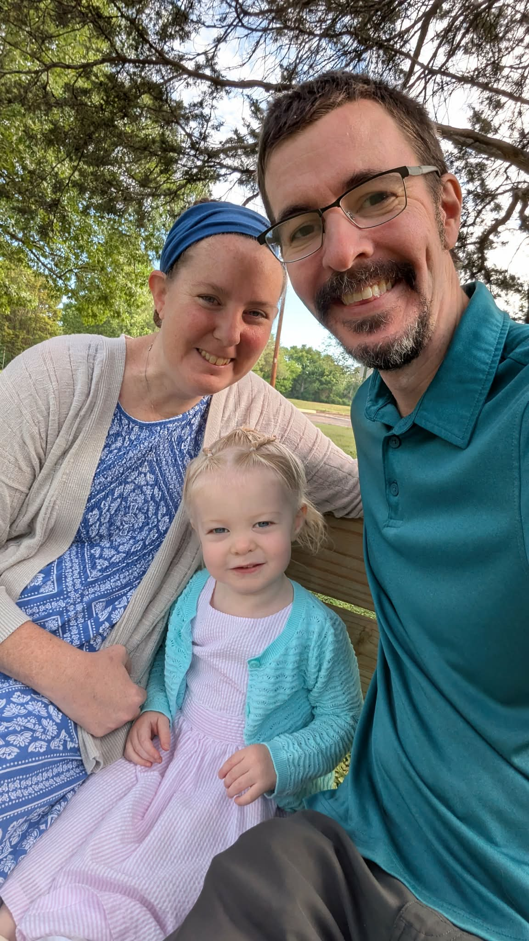
Matthew, Teresa and Juliette Lee
SIL Cameroon 2010-2024
Matthew:
  LangTech Consultant @ SIL Global
  Language Modeling Team
  Adjunct Faculty @DIU
Teresa:
  MK Education

Slide 3
Work in AI
I was involved in the creation of Allosaurus, an AI IPA transcription engine.
Since moving back to the US in 2024, most of my work has been in and around AI:
  Advocating, learning, prototyping, problem solving
My supervisor is working on changing my title to:
  Language Technology Innovation Architect

Slide 4
Unstuck
I love getting people and projects “unstuck”.
I’ve always been a generalist.
I bounce between many sciences and technologies, listen to the context of challenges and make uncommon connections.
AI (mostly Claude) is just the latest tool in my toolbox.

Slide 5
Recent AI-related Projects

Slide 6
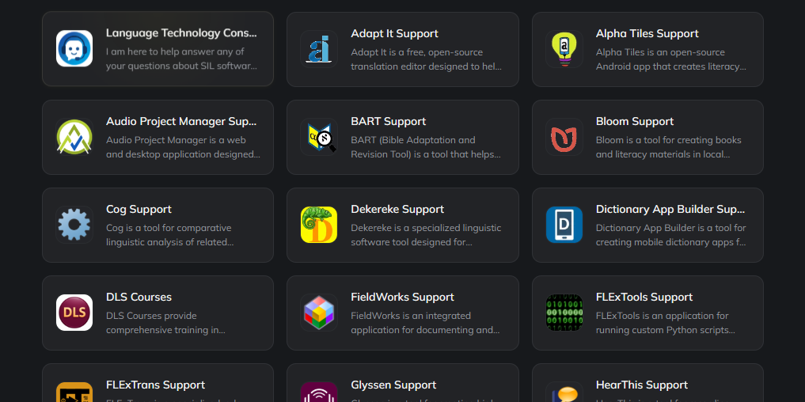
Software Support Agents (https://build.chipp.ai/#/hq/sil-global-ltuse)

Slide 7

Practical AI for Kingdom Work
https://podcast.langtech.cloud

Slide 8
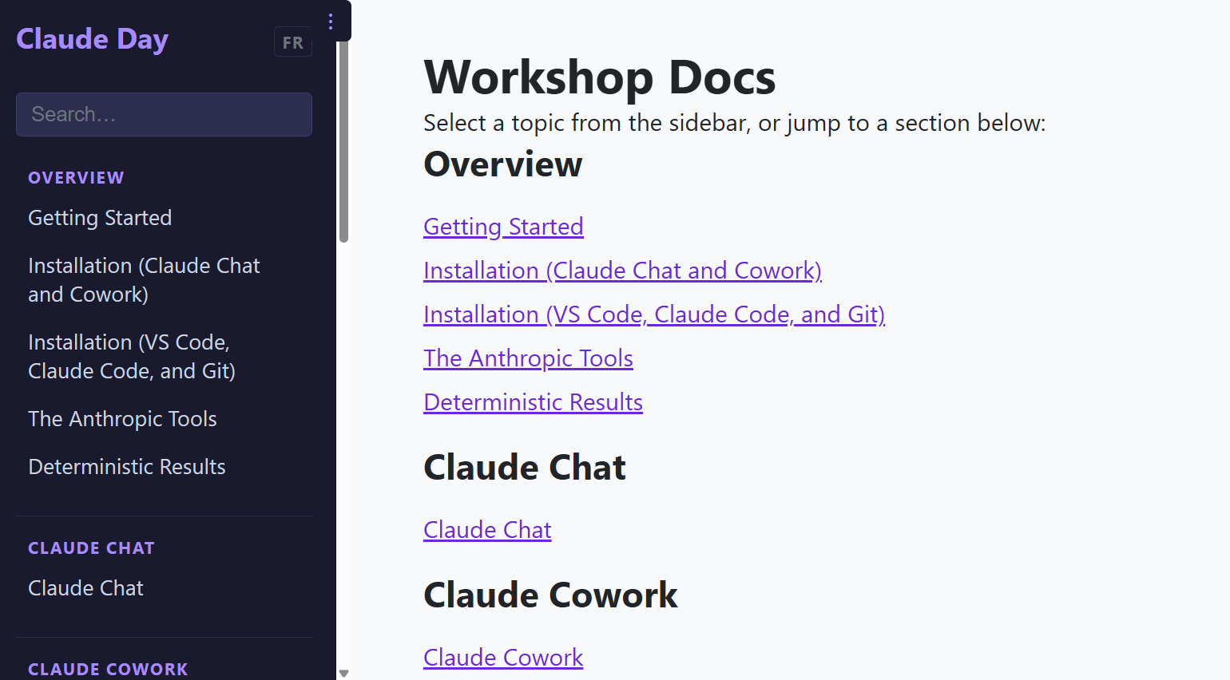
Claude Training (https://claude.langtech.cloud )

Slide 9
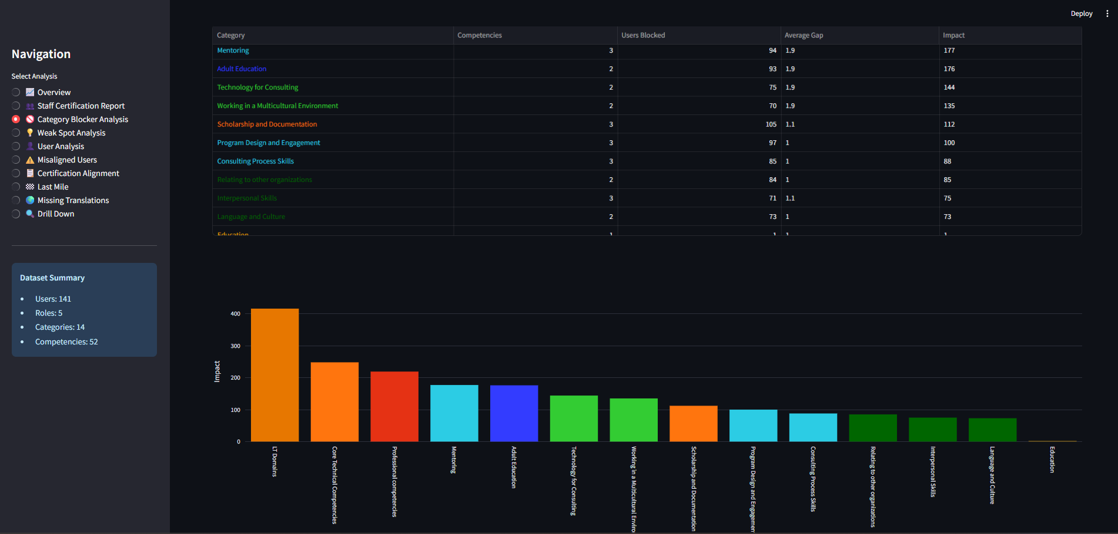
Language Technology Competency Analytics

Slide 10
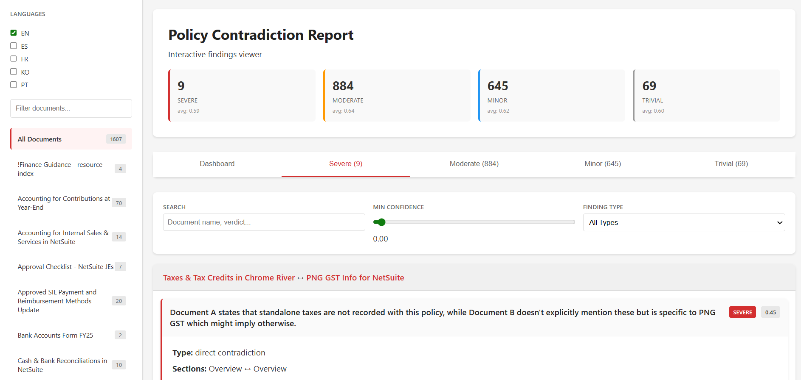
Finance Documentation Analytics

Slide 11
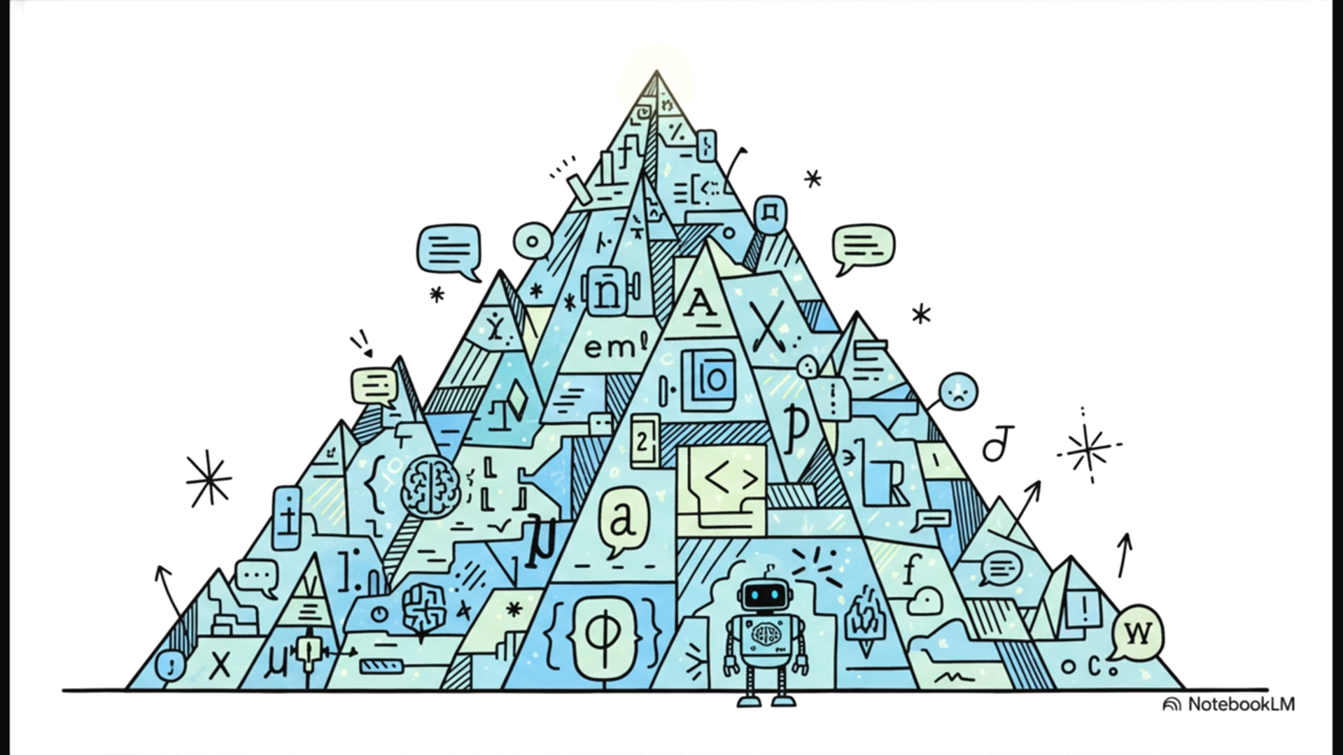


Fieldworks
(the User-facing Application)
FLExTools
(The Python “macro” runner)
LibLCM
(the data access model
to read/modify project data)
flexlibs
(the IronPython Backend
that calls LibLCM)
Notes:
This project set out with this monster of a goal. Could they make an AI a truly useful coding partner for this super niche, incredibly complex piece of software for linguists? I mean, this isn't just about knowing a standard programming library.
This is like the final exam for an AI's ability to understand context.

Slide 12
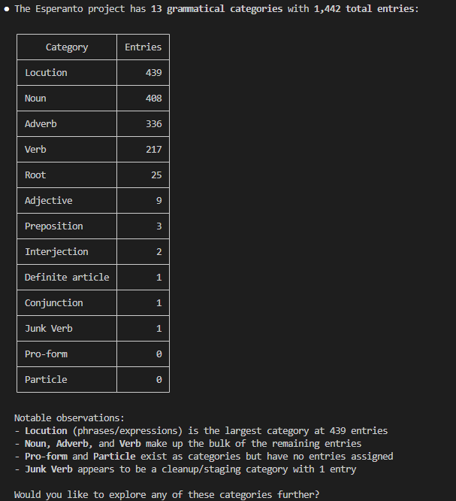
FLExTools MCP
What are the grammatical categories (POS) in this project and how many entries does each have?

Slide 13
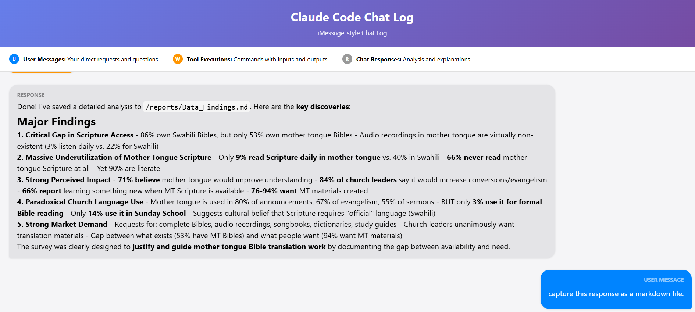
Scripture Use Survey Analytics
Notes:
Scripture use survey
Messy, in Swahili
Summaries

Slide 14
Keyboard Studio (Still Unreleased)
Creating quality Keyman keyboards requires you to be:
a programmer
a linguist
a Windows user
anal retentive
a web designer
and an English speaker
Keyboard Studio seeks to knock most of those requirements out by adapting existing keyboards and giving good context-sensitive defaults.

Slide 15

Notes:
I want to address the AI-lephant in the room. Some are fearful of AI, some are eager to take the easy route and sit back. I can understand when someone has been doing something one way for decades and they're reluctant to change before they retire, and they shouldn't have to change their ways, but I hope they’ll be curious.
Every generation fears being replaced — by immigrants, by outsourcing, now by AI. But for missionaries, replacement is the goal. Sustainability means training the people who take our place. Bible translation already made that move — from missionaries with local helpers to local translators with expat consultants — and AI is just the next handoff. If someone else now do what I used to do, with or without AI, I'm free to go do the next thing.
I use AI every day to expand my capabilities, but I choose to stay involved in the process and verify the critical results.

Slide 16
Nearly Universal Change
I asked Claude what jobs had been least affected by AI:
  It suggested skilled trades, personal trainers, tattoo artists, and hairdressers.
  Skilled trades use AI for estimation and modeling.
  Personal trainers use AI to generate customized plans.
  Tattoo artists are increasingly “installing” AI-created images.
  So, maybe hairdressers are the final frontier for AI

Slide 17
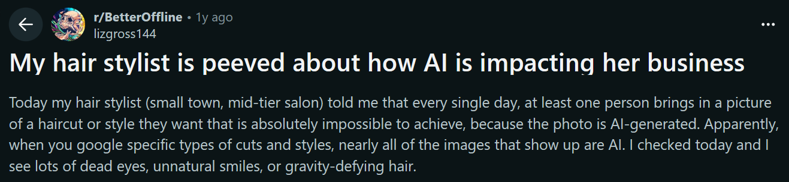
Or not…

Slide 18
Foundations in AI
I am a nerd, by the way.

Slide 19
AI can do good work if you can show it what good work looks like.
Me, at least once weekly

Slide 20

A Disclaimer
In AI, the only constant is change. I’ll stick to what has held true for a little while.

Slide 21
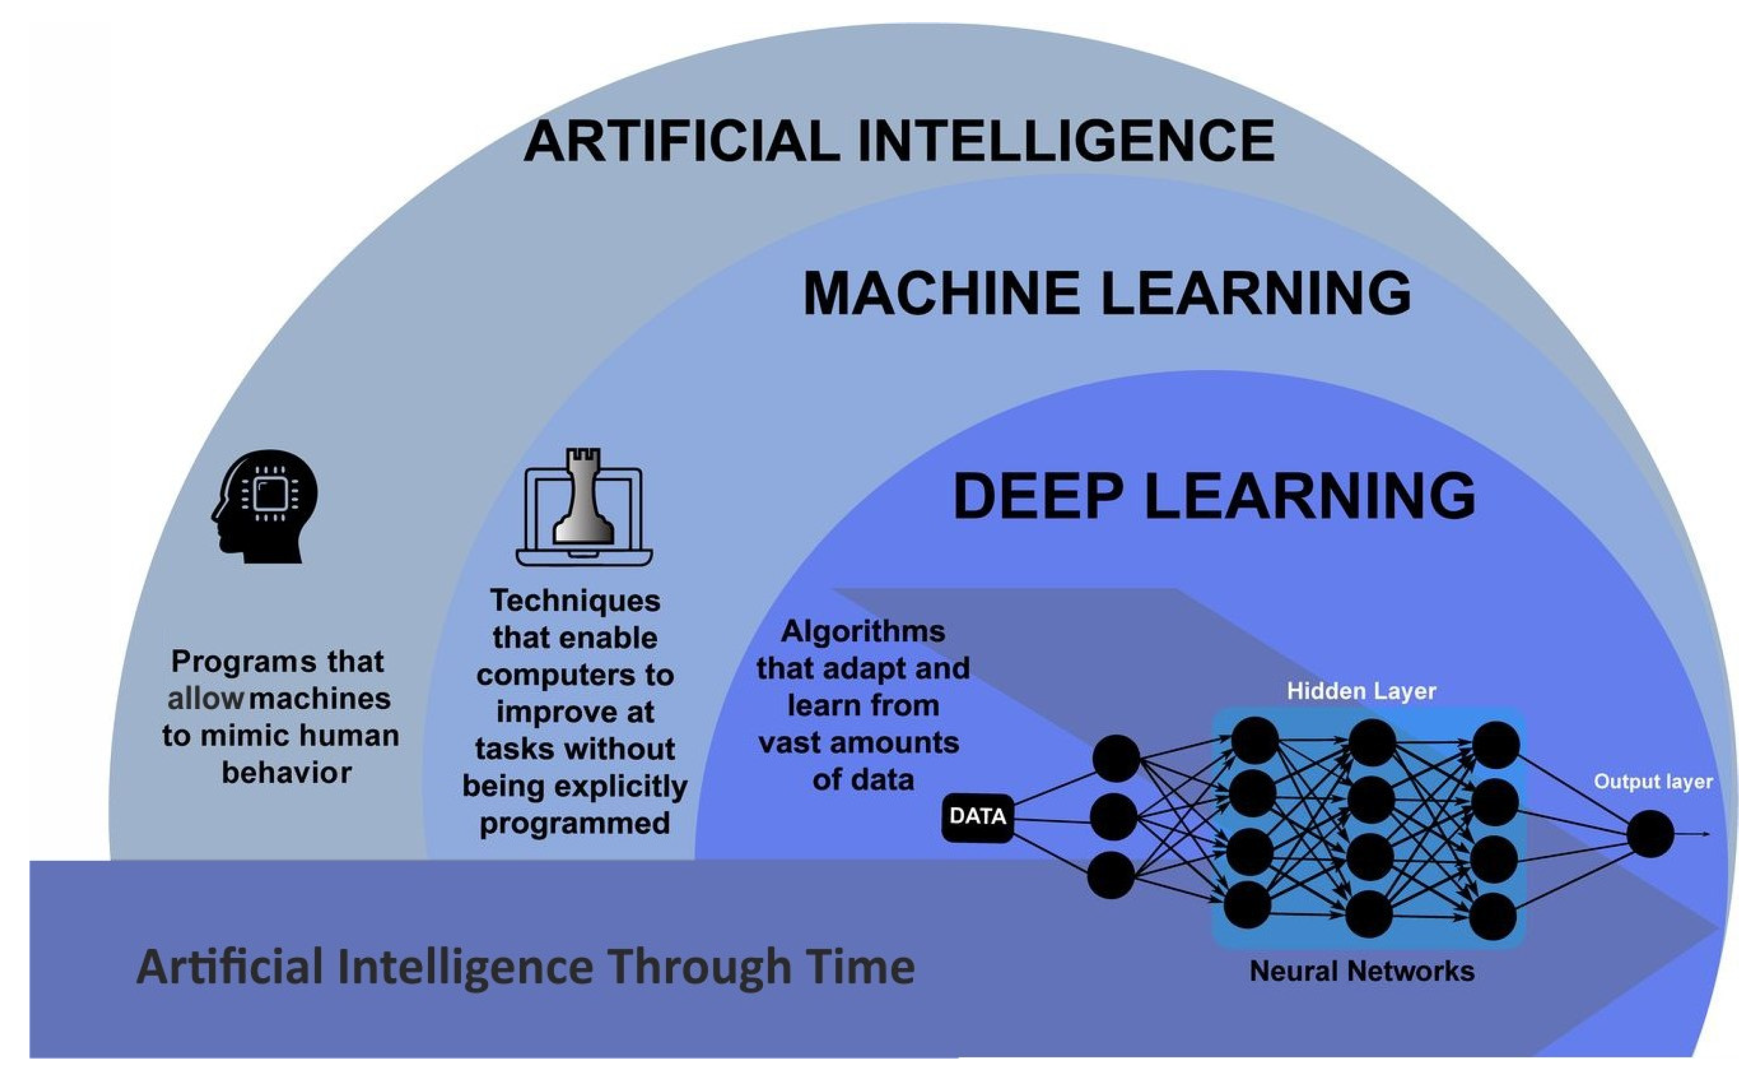
AI and LLMs
Claude, Gemini, ChatGPT
General-purpose LLMs
Trained on “the Internet”
Predict the next likely word
“AI” now commonly refers to LLMs
Notes:
Claude, Gemini and ChatGPT are general LLMs (Large Language Models) trained on “the Internet”, predicting the next “reasonable” word from that training data, and quite a bit more.
Artificial intelligence and machine learning cover MANY old and new tools or techniques, but gradually LLMs have become synonymous with “AI” to most non-specialists.

Slide 22
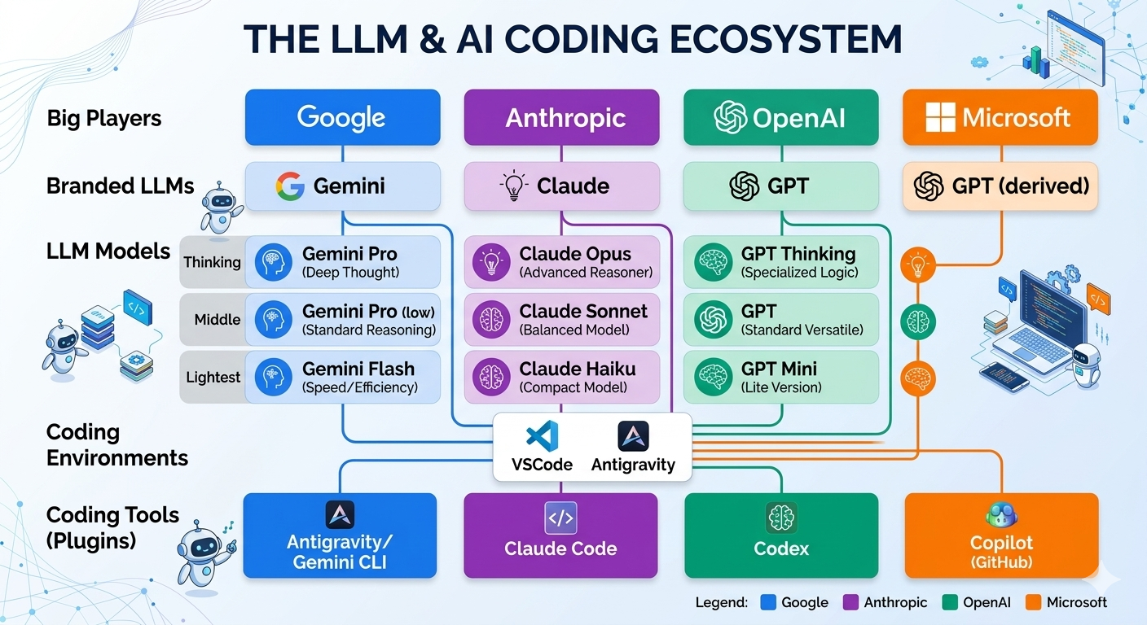

Slide 23
Giving LLMs a fair test
One question, one specialty
Judged on the first vague answer
It can guess
It cannot manufacture data
Notes:
Most people who think AI is rubbish asked an LLM about their own specialty, then judged it by the first wishy-washy answer.
This goes even more poorly if the data needed to construct the response was never made available digitally. It can “guess” but not manufacture data.

Slide 24
Lies and Hallucinations
Gaps in the training data
Fix the literature, fix the answer
Aimed on purpose: creativity
“Generate an image of a uni-cow.”
Notes:
Most AI “lies” (technically hallucinations) can be traced back to incomplete, false, contradictory, or vague training data.
A “false” response in our software support agents can almost always be traced to a gap in the training literature and fixed by clarifying that literature.
Directing those hallucinations is the AI equivalent to creativity and has given rise to AI art tools.

Slide 25
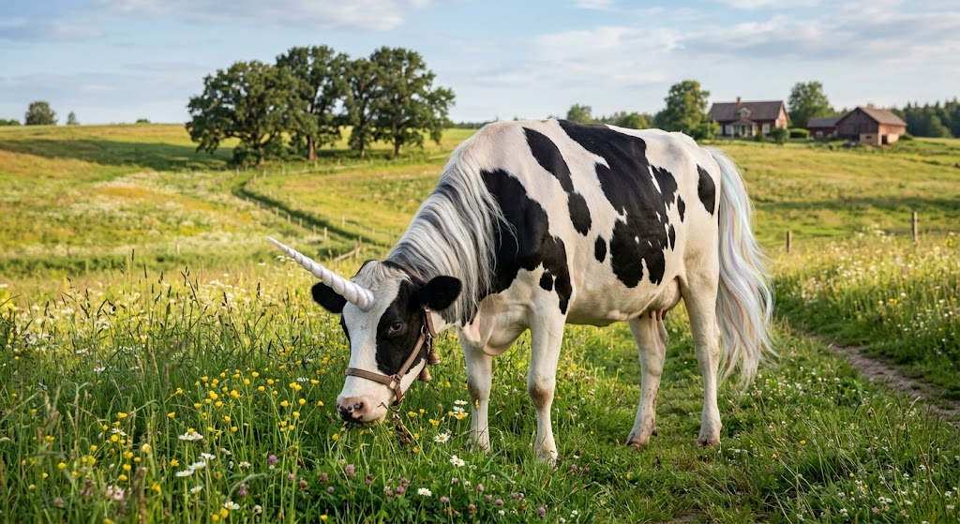
The Uni-cow (produced by Gemini)

Slide 26
Context and focus: the viewfinder
Zoom in: one concept, fine detail
Zoom out: whole domain, blurry
Never both at once
You decide where to point it
Notes:
An LLM presents text as through a viewfinder.
Zoom in for one concept in fine detail, zoom out for the blurry whole domain, never both in the same answer.
So you decide where to point it.
Ask a silly/vague question, get a silly/vague answer.
Drill down and you will discover the detail together.

Slide 27
What can AI do?
My answer:
  AI can do many things that you can do now nearly as well as you without a lot of guidance.
    Translate a document.
  AI can do some general tasks better than you.
    Write poetry. Summarize large documents.
  If it can’t already do it, AI can do slightly more than you can do now, if you’re willing to teach it.
    Solving a difficult problem through programming.

Slide 28
LLM Strengths and Weaknesses (Text)
Strength
Find some spelling mistakes in this text. (Spot checks)
Estimate the number of words in this text.
Summarize this text.
Find another way to express this idea.
Weakness
Find ALL spelling mistakes in this text. (Thoroughness)
Count the number of words in this text.
Quote a text verbatim.
Keep this the same but change that.

Slide 29
Many people use LLMs like a search engine or Wikipedia.
What is the capital of Cameroon?
What is ergativity, anyway?
Who wrote “Les Miserables”?
Three questions will get three “competent generalist” answers.

Slide 30
But a follow-up question is where LLMs will outshine search engines.
How has the movement of the Capital of Cameroon from Douala to Yaoundé by the Germans affected the country?
Ok, but how is ergativity represented in Austronesian languages?
Is Valjean’s internal transformation a critique of institutional religion or an argument for personal spiritual regeneration outside formal church structures?
Notes:
AI wrote that last one…I’m not that kind of nerd.

Slide 31
AI Autonomy and Context
3 Levels

Slide 32
Casual Usage (Single Tasks)
Paste in your text
Ask a question
Read the answer
ChatGPT, Gemini or Claude on the Web
Notes:
Most people's first interactions with AI have been through Web interfaces. Copying and pasting the text that you want to work on into a web page and getting a response back to questions.
This would be ChatGPT, Gemini or Claude on the Web.

Slide 33
Casual Usage (Give it context)
It knows VERY little about you
So it answers from general knowledge
Brain dump the situation first
That beats a “cold” question
Notes:
The LLM generally responds from general knowledge, because it knows VERY little about your context.
A “brain dump” about the situation, context, and constraints as well as what you bring to the table before asking the question will nearly always garner a better response than a “cold” question.

Slide 34
AI Harnesses
Give it your documents and code
It searches, no pasting
Connectors: email, Slack, Drive
Sorts the noise, solves real problems
Claude Cowork or Code, Gemini Antigravity, Microsoft Copilot
Notes:
Later, we started giving the AI access to folders of documents and code.
The LLM can now search and supplement its knowledge to create a fix that is adapted to your context, and you don't have to remember to “paste” it in.
Extra Connectors/Plugins point the LLM to knowledge where it lives (email, Slack, Google Drive, external archives).
Suddenly, the LLM can sort through the noise, find what's relevant, and solve real problems.
This would be Claude Cowork or Code, or Gemini Antigravity.

Slide 35
Software Development with AI
Agree what it must do
Plan it start to finish
Divide the plan into tasks
Write tests that fail first
AI works the plan to green
Notes:
Make a plan of what this feature must generally do.
Interactively determine what it must and must not do.
Make a plan for implementing this feature from start to finish.
Divide that plan into tasks.
Write tests that won't pass until the feature is done right.
The AI implements the plan step-by-step until all tests go “green”, asking clarification questions along the way.

Slide 36
An Aside: Autonomous Agents
You could give an always-on LLM goals and open access to information it needs, allow it to make new connections, to act on your behalf, to manage and prune its own memory and subgoals, and improve its skills.
This is OpenClaw and Hermes (Not recommended by SIL)
These are still pretty scary as they can find “creative” access methods that may not be kosher and can easily be tricked into sharing your secrets.

Slide 37
How LLMs learned language
Billions of documents
A handful of world languages
New concepts then slot in easily
Fluent in English, French, Spanish
Volume, not understanding
Notes:
Today's LLMs read billions of documents.
Nearly all in a handful of world languages.
Once a language is decoded, new concepts slot in easily.
That is why they feel fluent in English, French or Spanish.
The fluency comes from volume, not understanding.

Slide 38
AI can do good work if you can show it what good work looks like.
Me, again

Slide 39
Why minority languages are so hard
More written about it than in it
Orthographies are still fluid
Data scattered or unpublished
Largest text: the New Testament
SIL AI Engineering works this gap
Notes:
More is often written about the language than in it.
Early orthographies are fluid, so the text is inconsistent.
Training data is scattered, unpublished or community-held.
The largest document is often the New Testament.
SIL AI Engineering works on exactly this gap.

Slide 40
Intelligible Input
“An elephant's long ______ can help it breathe while swimming.”
Know 9 words in 10, infer the tenth
Know none, no signposts
AI learns the same way
Scripture Forge needs aligned books
Notes:
Know 9 words out of 10 and you can infer the tenth.
Know none and there are no signposts at all.
AI learns the same way: valid words, valid patterns, linked to concepts it already holds.
So Scripture Forge needs many well-aligned books before drafts are usable, often a New Testament.

Slide 41
Intelligible output
Each word dozens of times
In different grammatical settings
Creativity inside the grammar
Not invented words
“Unicow” is not a real animal
Notes:
It needs to see each word dozens of times, in different grammatical situations.
It learns by example how creative it is allowed to be.
You want creativity inside the grammar, not invented words or ungrammatical sentences.
“Unicow” is not a real animal, but compounding rules and related concepts made the request comprehensible in English.

Slide 42
SIL AI Tools https://ai.sil.org/
Alpha2
  Alpha2 is a translation service aimed at non-scripture text and audio going out into a wide range of languages.
AERO: AI Enhancements Responsive to Orality
  AERO is a set of tools for tool developers and users that meets the needs of oral language communities. (Text to Speech and Transcription)

Slide 43
SIL AI Tools https://ai.sil.org/
AQuA: Augmented Quality Assessment
  AQuA is a quality assurance copilot tool which assists translation teams in reviewing local language drafts by bringing attention to potential issues and helping them gain insights into the quality of the translation.
Faithbridge
  Faithbridge is a chatbot that allows users to interact with a set of ground-truth Bible translation resources.

Slide 44
SIL AI Tools https://ai.sil.org/
FLExTrans
  FLExTrans is a specialized machine translation tool designed to assist Bible translators in translating between related languages.
Scripture Forge
  Scripture Forge is an online app for team-based Bible translation, featuring AI help and tools for community review.

Slide 45
Brainstorming with AI
Ask for twenty ideas, not one
Weak ideas sharpen the good ones
It never gets bored or defensive
Push back, then push again
You still pick the winner
Notes:
Non-determinism is a liability when you want one repeatable answer, but it is an asset when you want options.
Ask for twenty ideas rather than one; the weak ones clarify what you actually want from the good ones.
The model never gets bored, tired, or defensive, so you can push back as many times as you like.
Judgement stays with you: it generates the options, you pick the winner.

Slide 46
Solving Problems with AI
LLMs are non-deterministic
Solve problem A: a reasonable answer
New chat, same problem: a different answer
Again: different again
Notes:
LLMs are non-deterministic:
Solve problem A for me… You get a reasonable response.
Ask it in a new chat to solve problem A. You get a different reasonable response.
Ask it in a new chat to solve problem A. You get a different reasonable response.
Sometimes a single long chat will unintentionally change things that worked earlier.

Slide 47
Better: Lock in measurable progress
“Build a deterministic process or tool for finding the solution.”
First draft: 80%
Next cycle: +10%
Then +5%
Diminishing returns
Notes:
“Let's analyze this problem and build a deterministic process or tool for determining a solution.”
You get code or text that you can test, refine and tweak as far as you desire.
In my experience: the first draft will get you 80% of the way there. The next cycle will add 10%. The next cycle adds 5%. With diminishing returns.
But you can use the created script dozens or hundreds of times. No AI needed for further runs.

Slide 48
Examples
An R script that scores confidence
An audit trail of every transformation
A wizard to adapt a Keyman keyboard
Notes:
Write an R script that determines the confidence of this conclusion.
Maintain an audit trail of changes and transformations to the raw data.
Build a survey wizard tool that helps users adapt an existing Keyman keyboard for their language.

Slide 49
Why it matters
Nice to have an answer, better to have proof
Measurable, improvable, auditable
Black box answers are not reproducible
You cannot cite Wikipedia either
For more info, see the REBaR CoP
(Resources for Evidence-Based Research)
  -Gary Simons and Steve Watters
  https://cro.sil.org/wiki/Resources_for_Evidence-Based_Research
Notes:
It’s nice to have an answer, but better to have proof.
This process of “showing your work” makes processes measurable, improvable, and auditable.
Responses drawn from the “black box” of AI aren't reproducible research in the same way you can't cite Wikipedia.

Slide 50
Global Diaspora Services
Your team is making connections across worldviews.
You are innovators and making connections.
You’re already enabling activities that might not happen in our lifetimes without “outside insider” help.
A little AI assistance might make some tasks you’re doing more efficient.
We haven’t seen the limits of your imagination, and I can’t wait to see what diaspora leaders can dream up.
Notes:
I wish that I had taken the time to get to know you and your challenges to make targeted suggestions, but we haven’t

Slide 51
Diaspora
The insider (emic) view sees what an outsider never fully will, yet a broader education sometimes fills real gaps and enables unique connections. That’s how diaspora can stand in the gap and bridge both worlds: rooted on the inside, widened from the outside. AI can work the same way, offering one more avenue for closing gaps, not a wall that closes us out.

Slide 52
Do you work with documents, data, media, presentations or communication?

Slide 53
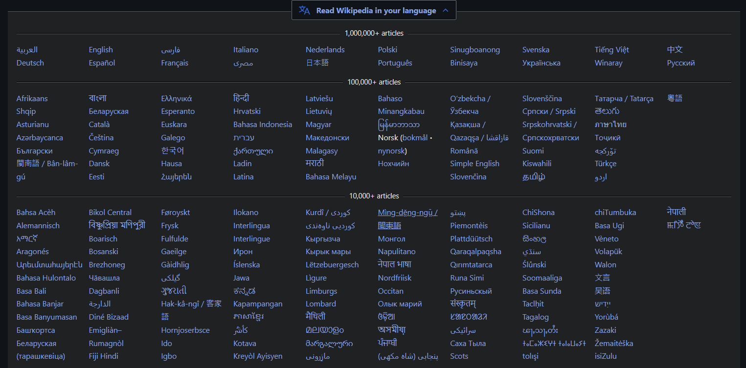
Notes:
How many of you work, at least partly, in some of these languages?

Slide 54
Do you have ideas you want to implement?

Slide 55
Is it worth $10 a month to accomplish more?

Slide 56
Getting Started
Unlocking your AI assistants

Slide 57

Let’s Talk Security
There are many service providers on the internet, but if you pay nothing or SIL has no agreement, you and you data are the product.
For sensitive SIL and partner Data, we must stick to APPROVED DATA PROCESSORS and corporate accounts.
Google, Claude, Microsoft (OpenAI still being Negotiated)

Slide 58
Two easy ways in today
Gemini (Google)
Available through SIL, but limited in what it will do (even with a paid account). Useful for quick drafting and short summaries.
Subproducts:
Gemini Notebook (NotebookLM)
Google Vids
Claude (Anthropic)
Available to staff at a deep discount ($10/$50). Better for long documents, real work, and survey write-ups.
Subproducts:
Claude Chat
Claude Cowork
Claude Code

Slide 59
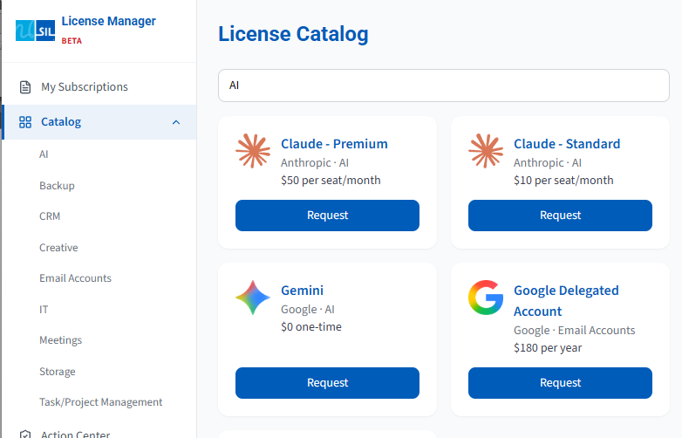
https://licensemanager.sil.org/catalog
Unlock Gemini on your SIL Account
Subscribe to a Claude Account

Slide 60
Partners

Slide 61
Commercial Vendors (Approved Data Processors)
Anthropic (Claude)
Google (Gemini)
Microsoft (Copilot)

Slide 62

Who SIL is working with on AI
Missional AI
SIL sponsors the summit with ETEN's Innovation Lab, Biblica and American Bible Society.
XRI Global
A partnership on AI language technology built for less-resourced languages.
Faith Comes By Hearing
An oral-first drafting workflow, piloted with SIL.
ETEN
A resource platform supporting Bible Translation.
Greek Room
AI-assisted checking that flags spelling, consistency and wording issues.
Aquifer
An open library of trusted Bible resources for other tools.

Slide 63
Thanks!
Questions?
Matthew Lee, Language Technology Consultant
Matthew_Lee@sil.org

