Slide 1
Language Technology
Half-Days 2021
2021
Notes:
Solid colours: ‘ ‘
Background shades: ‘ ‘

Slide 2
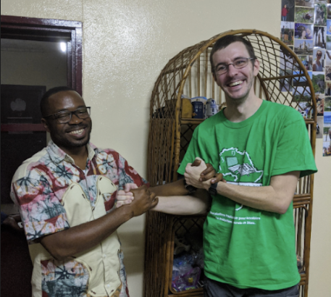
The Team:
NGONO Louis Pascal and Matthew Lee

Slide 3
A Guide to Working with Me (Matthew Lee)

Slide 4
ADHD
While on furlough, I was diagnosed with Adult ADHD.
  (Most of you weren’t surprised.)
This is not adult-onset ADHD, it just means that some of my struggles have persisted into adulthood. Note: They lower the bar for diagnosis for adults because you have probably learned to mask or work around some symptoms by now.
The medication that I can get in Cameroon is less effective than what I had in the states.

Slide 5
Differently-Abled
The “superpower” of hyperfocus makes me effective in research and complex problem-solving. It also helps me to focus clearly and function in a crisis situation.
The “kryptonite” of split focus makes it very hard to start or finish work that is uninteresting.

Slide 6
Differently-Abled
Time blindness and lack of internal motivation keep me from realizing how long a task is taking, has taken, or how long I have put it off.
I have no internal meter for judging priority and acting appropriately.
Because of a catastrophic burnout before Wycliffe that changed my personality, I no longer have much of the anxiety that cripples many folks with ADHD.

Slide 7
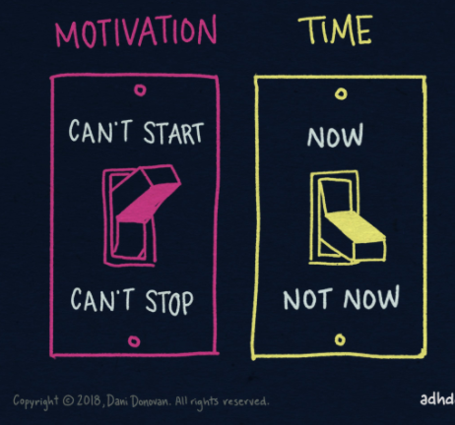
Motivation
From: https://twitter.com/danidonovan/status/1148720594361430016/photo/4

Slide 8
Motivation
I may struggle to start tasks that don’t trigger me.
  It’s even harder to finish these because,
  SQUIRREL (anything else may trigger me)!
I may struggle to stop tasks that do trigger me.
  It’s hard to finish these because of the rabbit trails and because perfectionism sets in over “pointless” details.
Breaking free of either tendency (without help or medication) takes massive emotional energy and may require a recovery time after.

Slide 9
Positive and Negative Factors
Is it interesting? Yes: 10x
Is it related to my field? Yes: 5x
Am I the right person to be asking? No: 0.01x
Does in involve research? Yes: 5x
Does it involve finance? Yes: 0.01x
Have I ever done this? No: 5x
Has anyone ever done this? No: 30x
Do I need to learn new skills? Yes: 3x
Do I already have some related skills? Yes: 3x
Do I have any of these skills (overwhelming)? No: 0.2x

Slide 10
Positive and Negative Factors
Is it currently after 9am? Yes: 2x, No: 0.3x
Is someone else better equipped to do this? Yes: 0.2x, No: 2x
Are you willing to work through the process with me? Yes: 50x
Do you want to learn how to do it? Yes: 50x
Can the result be re-used in the future? Yes: 5x
Is it repetitive? Yes: (see below)
If repetitive, are you asking me to automate it? Yes: 5x, No: 0.01x
Is there a deadline? Urgent: 10x, Long-term: 2x, No 0.0001x

Slide 11
Positive and Negative Factors
Sidenote:
This is not a refusal to do un-interesting tasks or a rational judgement of their merits.
  I simply may need to lean on some external motivation (deadlines, reminders, or pressure).

Slide 12
Time
From: https://twitter.com/danidonovan/status/1148720594361430016/photo/4
Notes:
I have 2 time periods, “Now” or “Not Now”.

Slide 13
“Now” and “Not Now”
When my wife says “Dinner will be ready in 5 minutes”, I hear “Dinner is NOT NOW”.

Slide 14


Working with You on a Project
Completion
Phase
Research
Phase
Notes:
Let’s look at the extreme cases.

Slide 15
Working with You
Sidenote:
If you want to learn part or all of the process, please stick around.
  Seeing your interest and learning together provide extra motivation.
  The result will be better if I can ask you questions along the way rather than guessing, and I won’t obsess on small things that don’t matter to you.
  I will tell you if there are processes you don’t need to follow.

Slide 16



Working Alone on a Project (with a Deadline)
Rabbit
Trail
Initial
Research
Phase
Learning a
New Skill
Completion
Phase
(Expected Completion)
Stated Deadline
Notes:
Research Phase (Getting an Idea of what will be required)
Rabbit Trail, AKA Research Composting
Learning a new skill I will need to compete the project
Completion Phase, Notice that it goes off the chart.
This works most of the time, except if someone has an earlier completion date in mind that they said, and then I accidentally end up stressing them out.

Slide 17


Working Alone on a Project (No Deadline)
Initial
Research
Phase
I see you in
the hallway.

Slide 18
Conclusions
I am much better at responding to your expressed needs than mind-reading.
I work best supporting your initiative (making you look good) rather than being in charge.
If I express reservations about an idea, this is not intended as a personal attack.
  I’m quite opinionated, but I don’t tend to complain unless I’m willing to offer an alternative and help.
    Please tell me if I overstep.

Slide 19
Conclusions
If you stick around, I’ll be motivated to help faster, even if the task doesn’t trigger my interests.
Please communicate your expectations and timeframe clearly, and I will do my best to fit in your project.
  (If possible, please tell me a reasonable expected time, rather than the final deadline that will stress you out.)
If a workshop or presentation is scheduled, I will give 110% to be ready for it just-in-time.

Slide 20
Conclusions
If I haven’t done what you asked me, it’s not because I don’t like you. Don’t be afraid to remind me (repeatedly).
Because I tend to feed off your motivation, tasks presented in person tend to trump those sent by email.
  When I am working with someone, I don’t tend to check my email, so try to call me or stop by.
  No response to your message tends to mean that I have no idea how to respond or start.

Slide 21
What can LangTech do?

Slide 22
Computers by Frank Herbert
What do such machines really do?
They increase the number of things we can do without thinking.
Things we do without thinking — there's the real danger.
À quoi servent de telles machines, en réalité?
À accroître le nombre des choses que nous pouvons faire sans y penser.
Voilà le vrai danger… les choses que nous faisons sans y penser.
Herbert, Frank. God Emperor of Dune. New York: Putnam, 1981.
Notes:
Herbert, Frank. God Emperor of Dune. New York: Putnam, 1981.

Slide 23
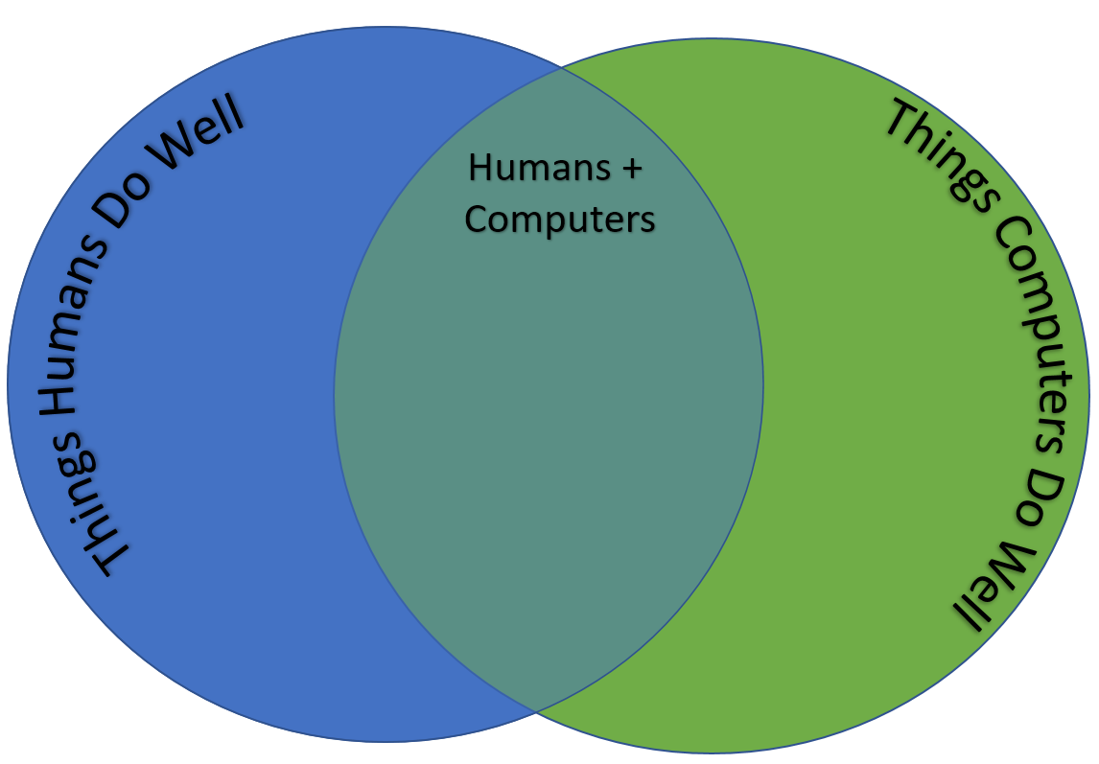
Notes:
Let’s do a bit of review.

Slide 24
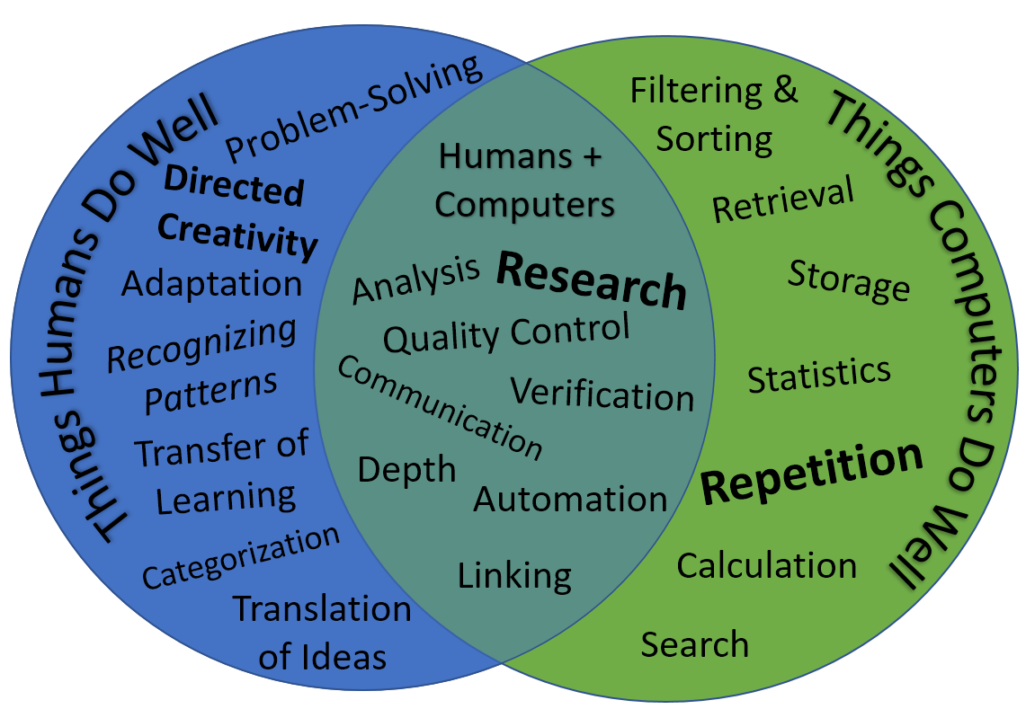

Slide 25
Foundational Technologies

Slide 26
Keyboards (Overview)
Cameroon Keyboard
  Android App
  Windows Keyboards
  Linux XKB
  Keyman Keyboard
  Keyboard App Creator
  Ukelele

Slide 27
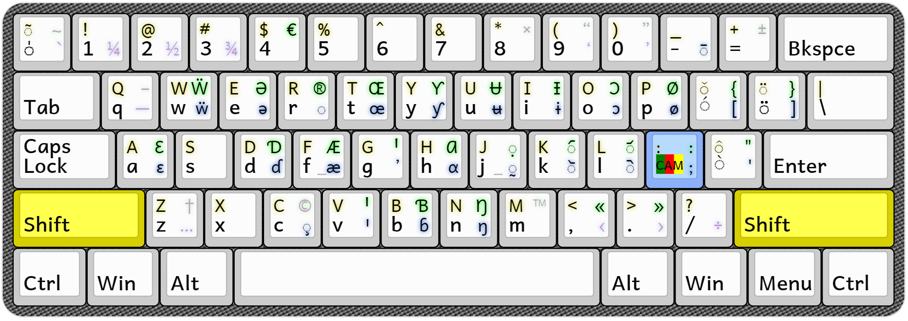
Keyman

Slide 28
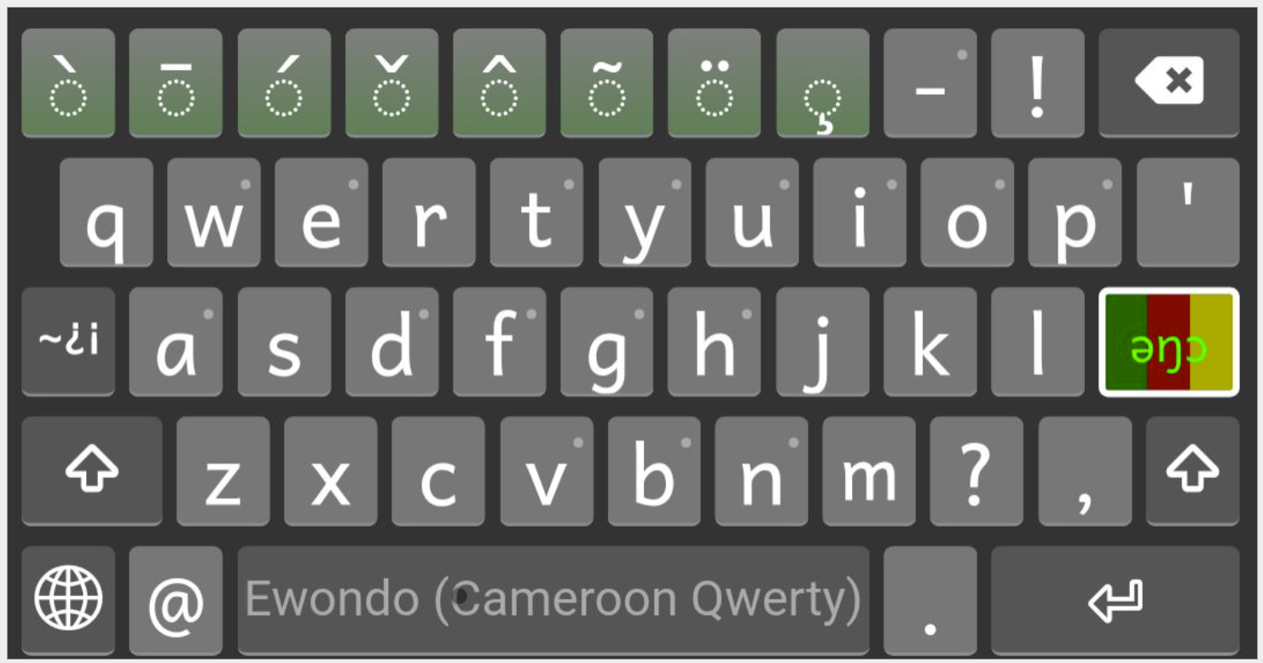
Keyman

Slide 29
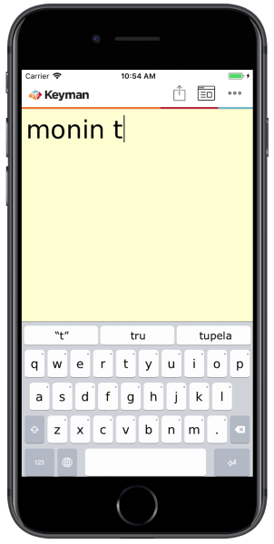
Predictive Text

Slide 30
Unicode Conversion (Overview)
SIL Converters
Tavultesoft Character Identifier
OO Linguistic Tools

Slide 31
Translation

Slide 32
Translation Tools (Overview)
Editing
  Paratext (and Paratext Lite)
  Adapt-It
  The Bible Translator’s Assistant
Checking
  Paratext
  ScriptureForge
  TransCelerator
  TranslationCore

Slide 33
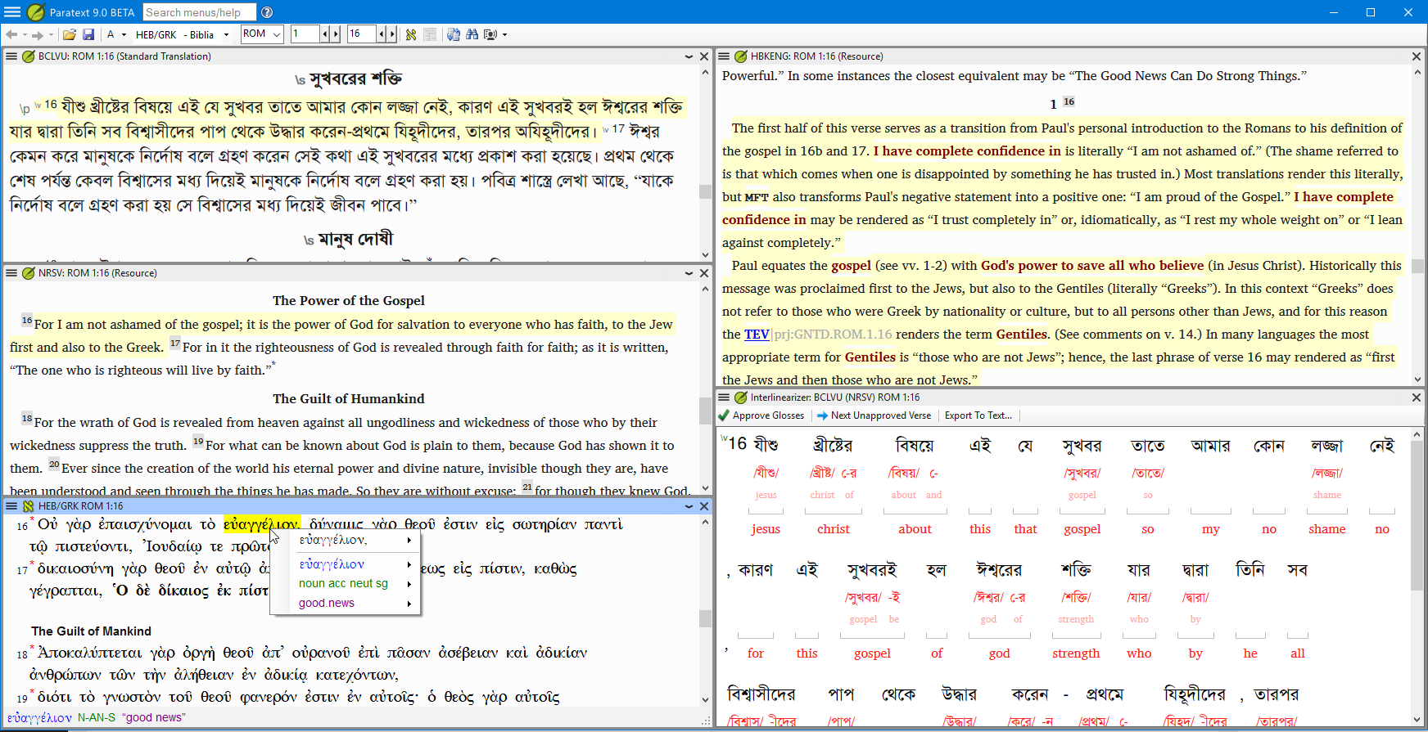
Paratext 9.1

Slide 34
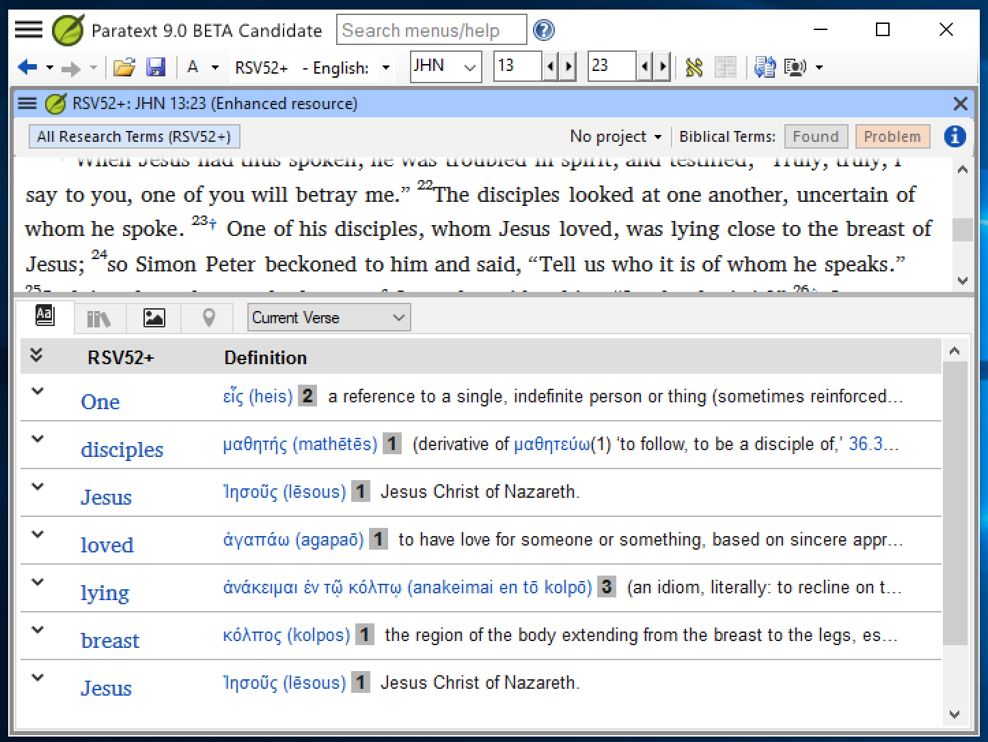
Paratext Enhanced Resources

Slide 35
Paratext Project Plans
International pressure to apply and update project plans.
SIL Compact Plan
Improvements to the Tool.

Slide 36
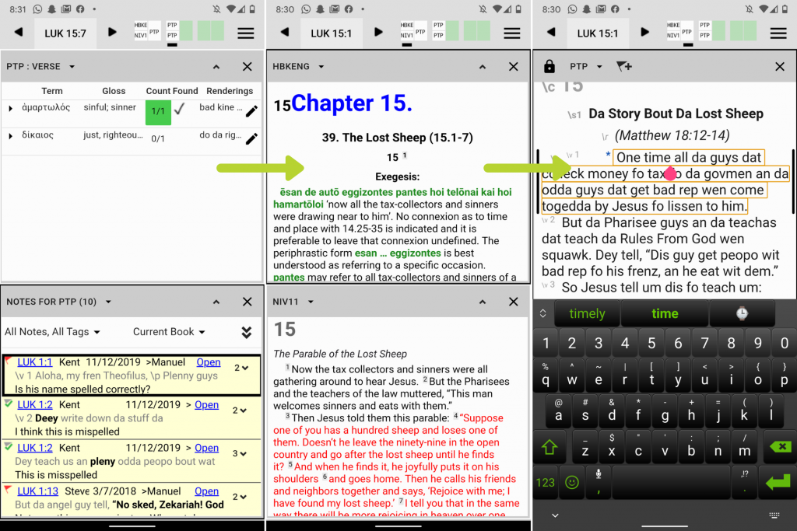
Paratext Lite
https://paratext.org/2020/10/28/paratext-lite/

Slide 37
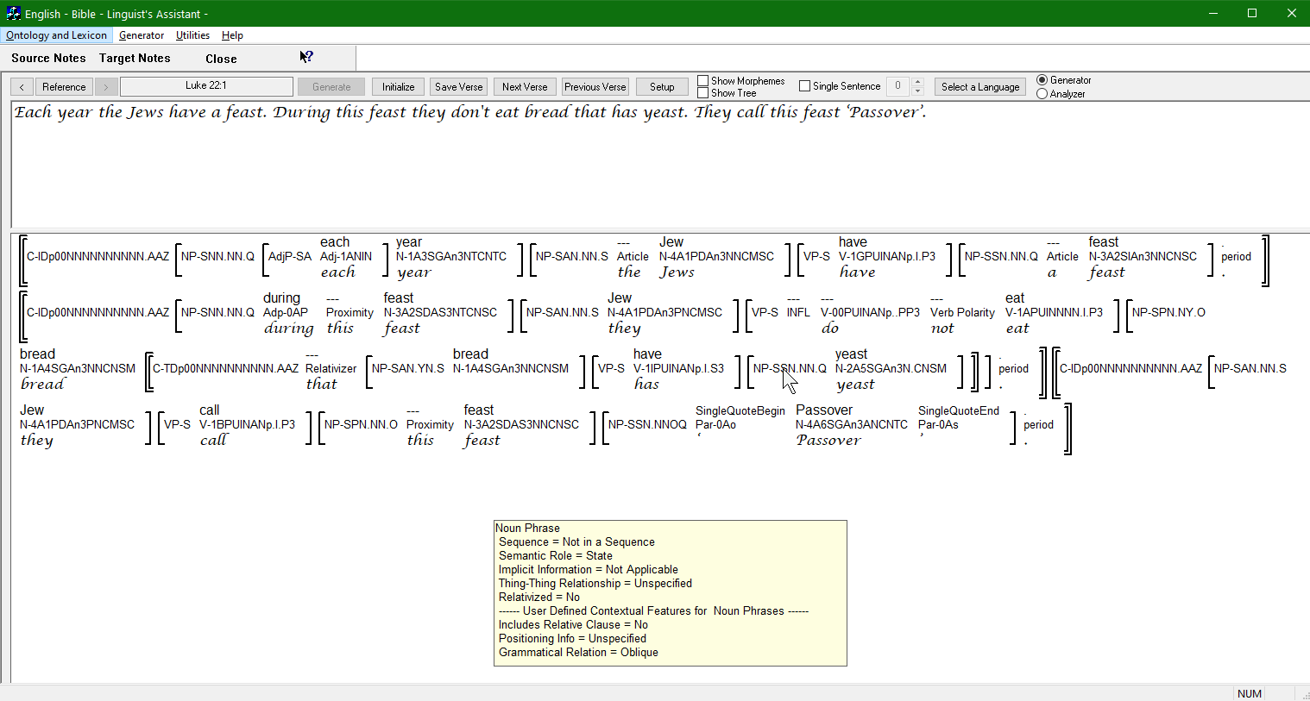
The Bible Translator’s Assistant

Slide 38
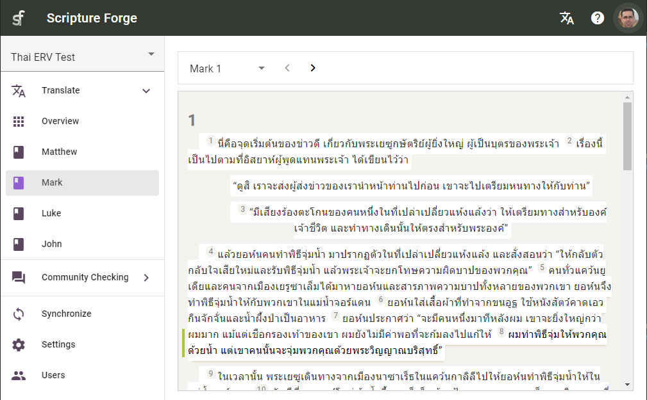
ScriptureForge

Slide 39
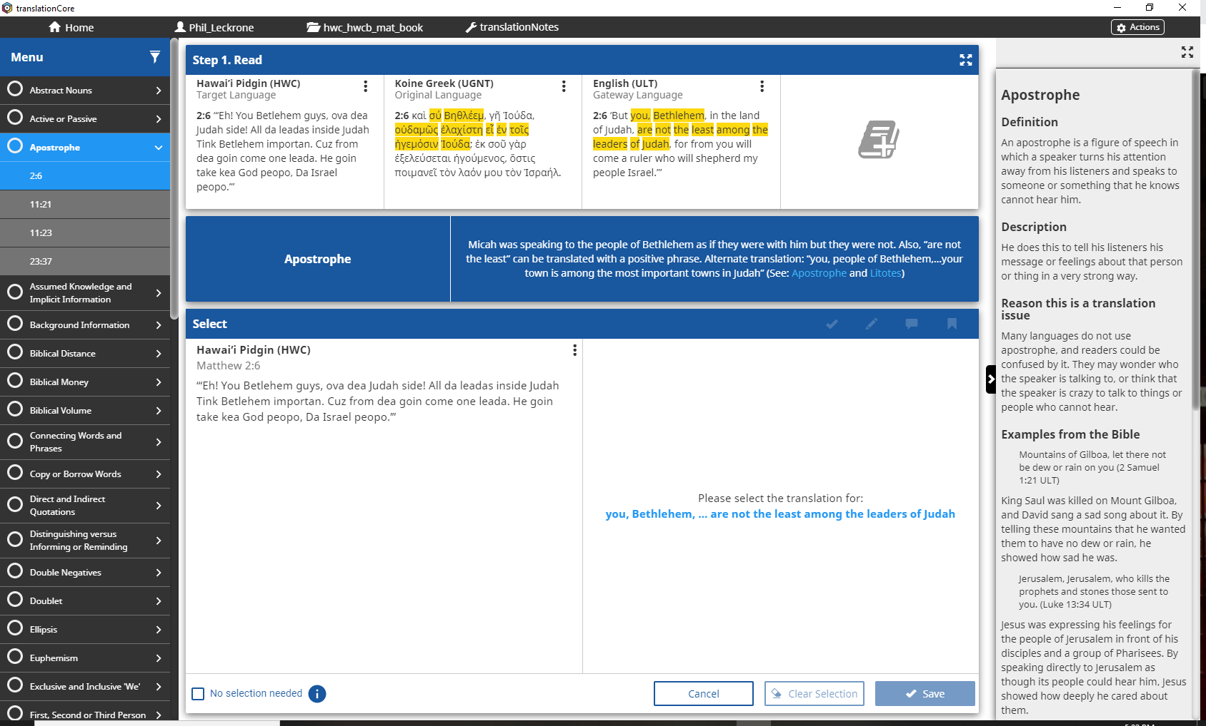
TranslationCore: Translation Checking Questions

Slide 40
Translation Resources (Overview)
Paratext Resources and Enhanced Resources
Translator’s Workplace Logos
Bureau de Traducteur Logos
Biblical Analysis and Research tool (BART)
Pupitre (Discontinued)

Slide 41
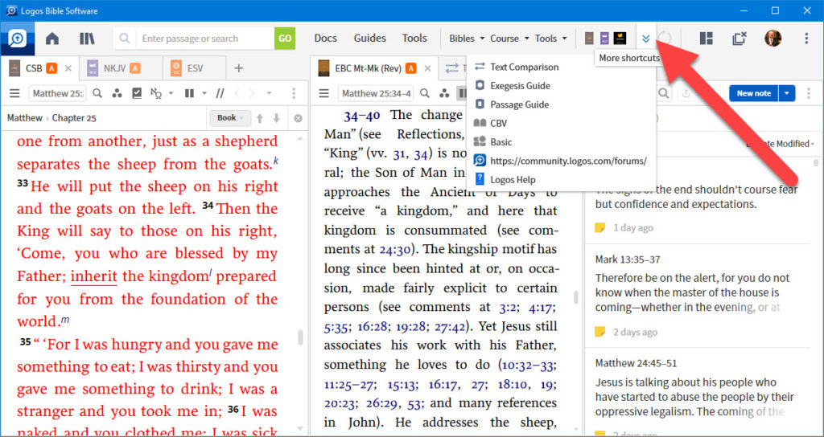
Translator’s Workplace Logos

Slide 42
Working with Oral Scripture (Overview)
Full Oral Process
  Render
Transcribing Oral Stories for Checking
  Transcriber
Recording Scripture
  Glyssen
  HearThis

Slide 43
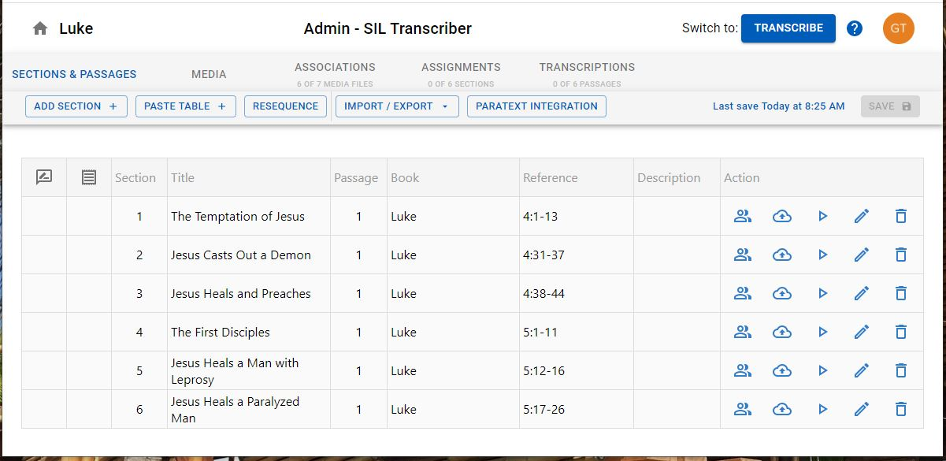
Transcriber (SIL)

Slide 44
Scripture Publishing (Overview)
Draft:
  PTXPrint
  Print Draft
Final:
  Publishing Assistant and inDesign
  Scripture App Builder

Slide 45
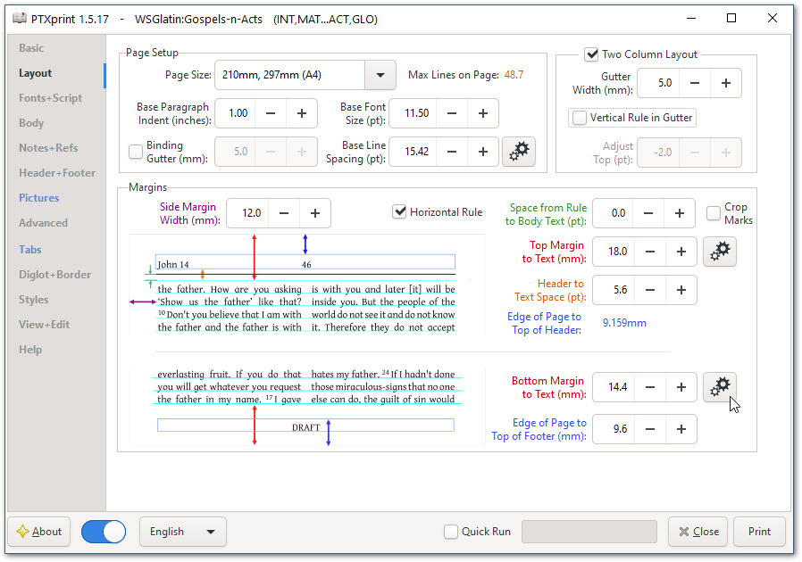
PTXPrint

Slide 46
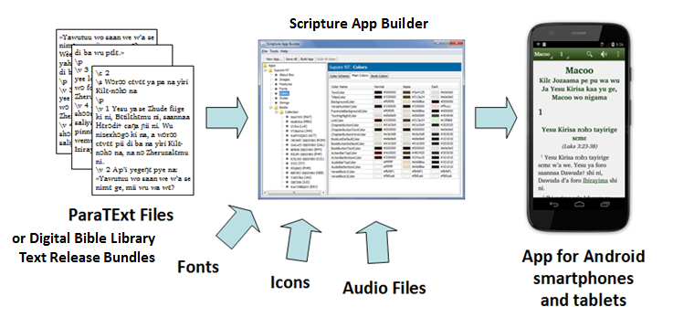
Scripture App Builder

Slide 47
Free Bible Images
https://www.freebibleimages.org/about/

Slide 48
Lessons from Luke
https://lessonsfromluke.gospelcoding.org/

Slide 49
Publishing

Slide 50
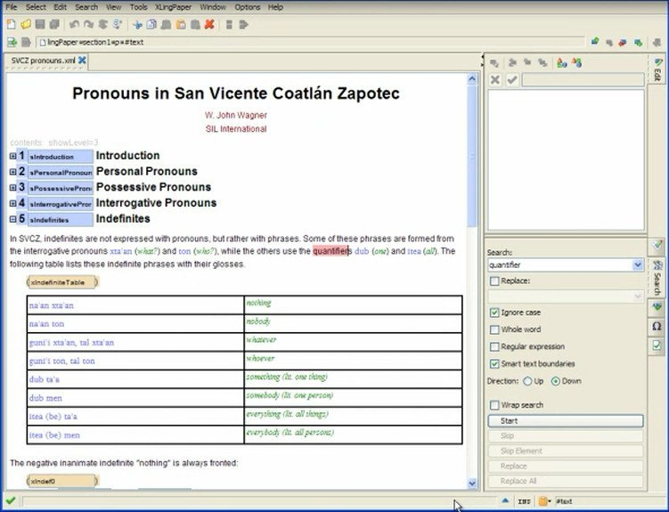
XLingPaper

Slide 51
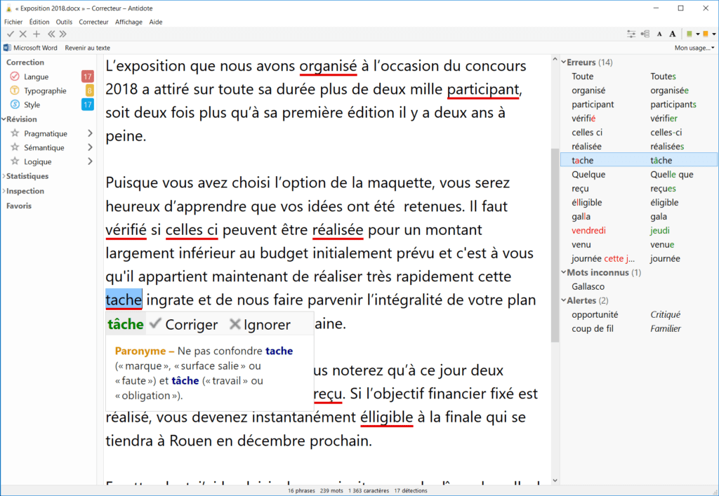
Antidote

Slide 52
Literacy

Slide 53
Primers (Overview)
WordLists and Teaching Order
  PrimerPrep
  Synphony
  Bloom
Making Books
  Bloom
  Desktop Publishing Software
  Bantu Literacy Tools?

Slide 54
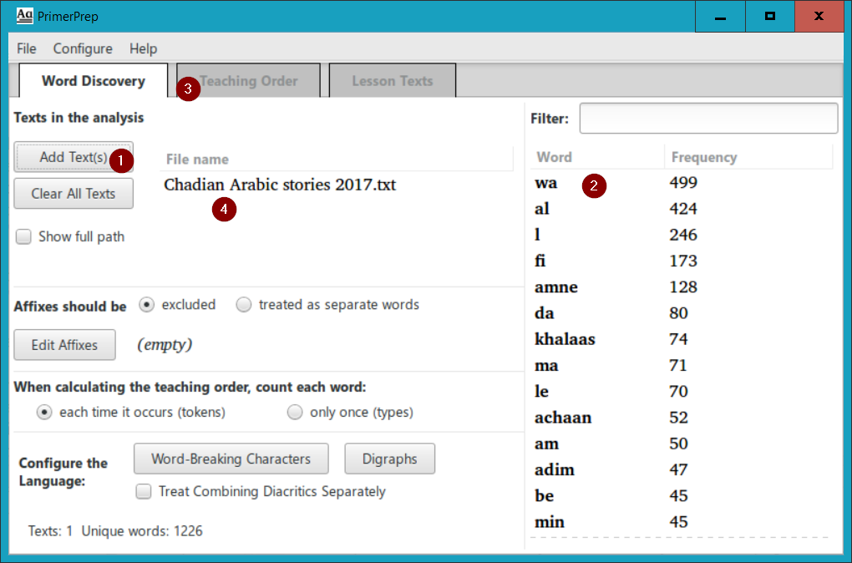
PrimerPrep

Slide 55
Shellbooks (Overview)
  Bloom
  Desktop Publishing Software

Slide 56
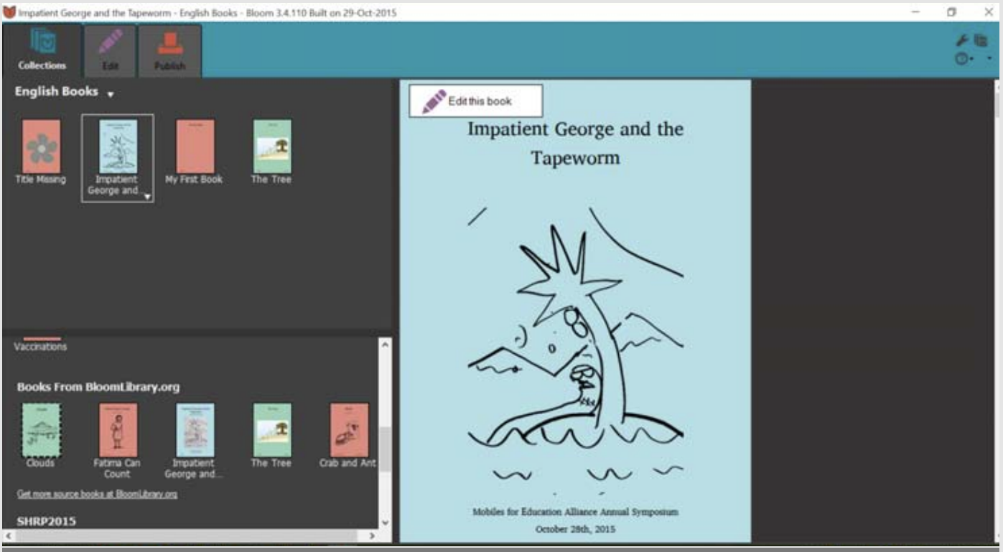
Bloom

Slide 57
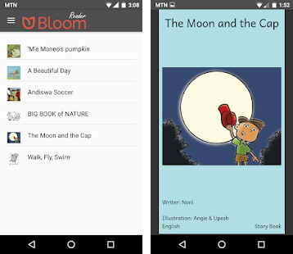
Bloom Reader

Slide 58
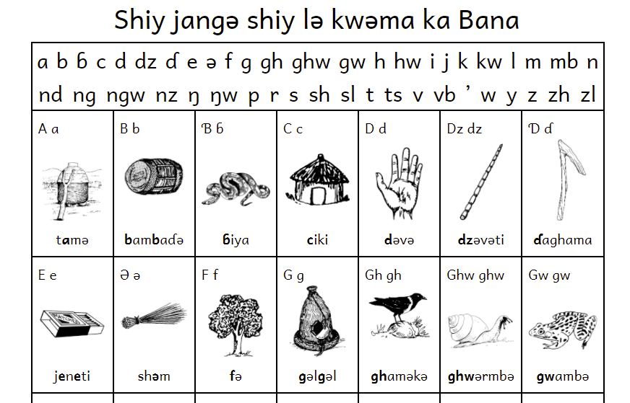
AlphaChart
https://alphachart.gospelcoding.org/

Slide 59
Linguistics

Slide 60
Word Collection (Overview)
(Wordlists or Rapid Word Collection)
FLEx
TheCombine
WeSay
WordSurv

Slide 61
Lexicon Development (Overview)
FLEx
LanguageForge
WeSay

Slide 62
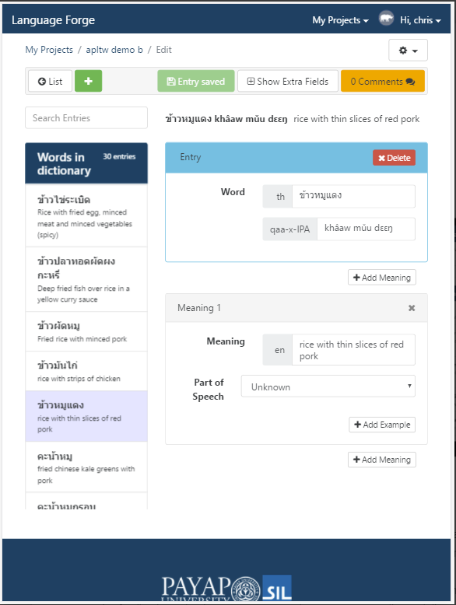
LanguageForge

Slide 63
Lexical Publishing (Overview)
Pathway
Dictionary App Builder
Webonary
Lexique Pro

Slide 64
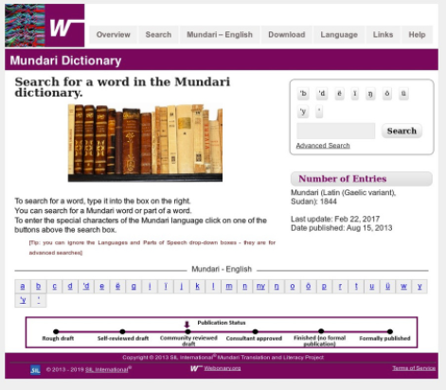
Webonary

Slide 65
Phonological Analysis (Overview)
Phonology Assistant
Speech Analyzer
Praat
PTEST

Slide 66
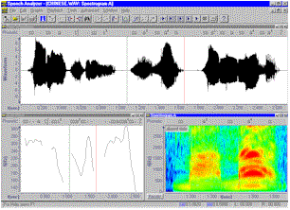
Speech Analyzer

Slide 67
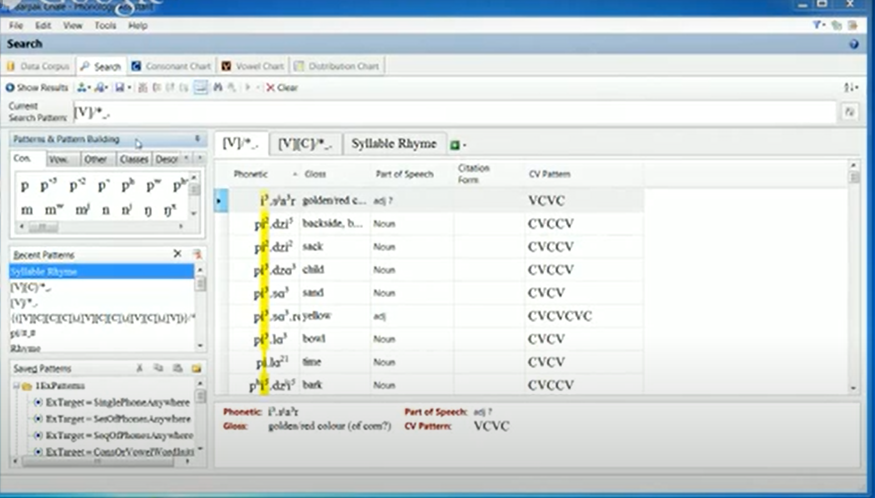
Phonology Assistant

Slide 68
Survey

Slide 69
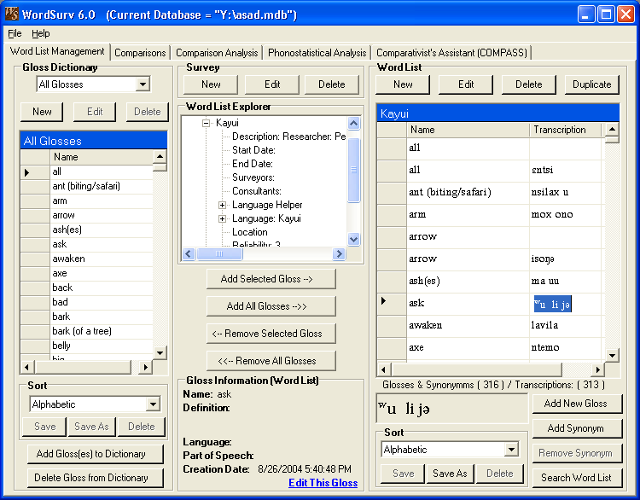
WordSurv

Slide 70
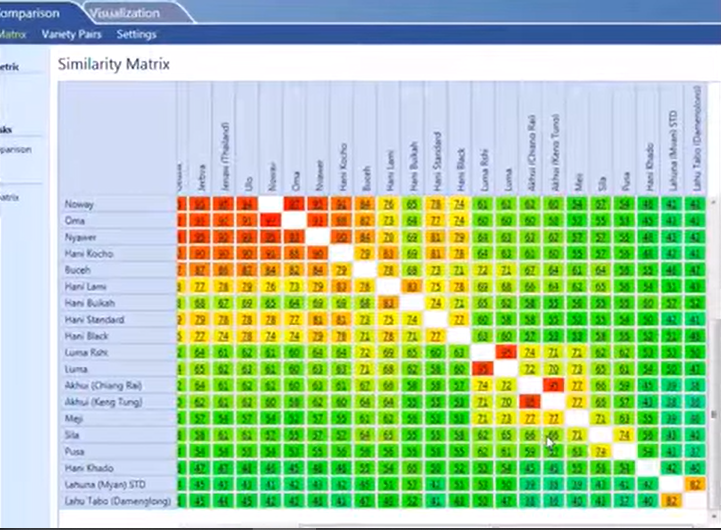
Cog

Slide 71
Language Documentation

Slide 72
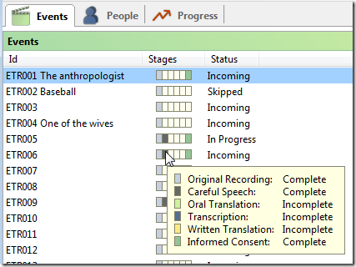
SayMore

Slide 73
Prestige

Slide 74
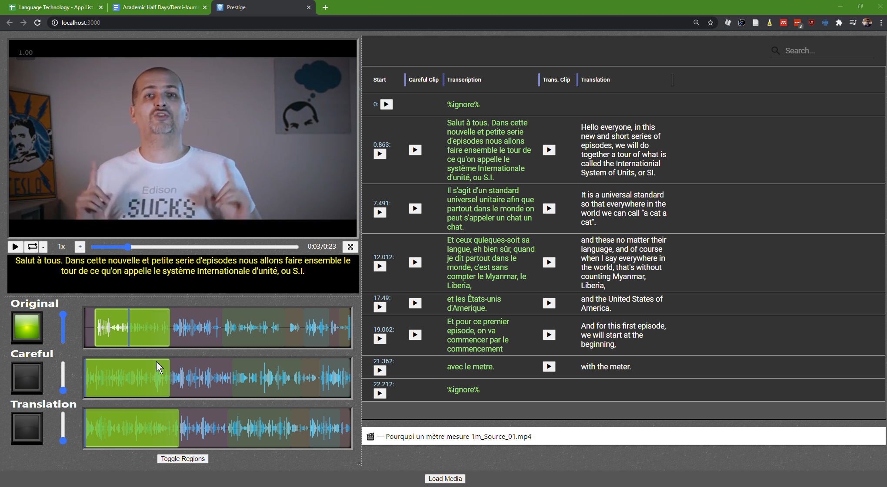
Prestige

Slide 75
Questions?

Slide 76
Motivation
My brain chemistry chooses those things I will naturally hyperfocus on and those that I have to fight to focus on.
  Hyperfocus tasks are usually novel or complex problems.
  Fight-to-focus tasks are the dull and repetitive ones.

Slide 77
Working Alone (with a Deadline)
The “Sweet” Spot
One thing I learned in college was NOT to try to finish a complex project too early.
  Some sections may not have been taught yet.
  As early birds hit hard problems, the objective may be clarified.
    If you push through and try to complete it too early, you’ll probably end up redoing a significant amount.
Start early to get a feel for what is needed, learn the basic skills as you go, do some early tests, but plan to do the final version near the end.
  Of course, all this backfires if another major projects come up.

Slide 78
Working Alone (with a Deadline)
Sidenote:
If you come to me with something that has a deadline in the distant future, I will get it done by the deadline, but don’t be surprised if I pull an all-nighter to do it just before the deadline.
  (If possible, please tell me a reasonable expected time, rather than the final deadline that will stress you out.)

